Slide 1


SC1015 Mini Project:
Predicting Song Popularity
CHUA JING JIE, JUSTIN
JESSIE ANG KAI PIN
LIM ZHE XUN
DSF 3, GROUP 10

Slide 2


SAMPLE
COLLECTION
PRACTICAL MOTIVATION
EXISTING STATISTICS
60,000 songs are uploaded to Spotify each day
> 365 million monthly users
> 11 million artists on the platform
Spotify pays $0.033 - $0.054 per stream
01 INTRODUCTION

Slide 3
SAMPLE
COLLECTION
PRACTICAL MOTIVATION
EXISTING STATISTICS
0.7% artists on Spotify earn 90% of the total revenue
Spotify pays $0.033 - $0.054 per stream
01 INTRODUCTION

Slide 4
SAMPLE
COLLECTION
PRACTICAL MOTIVATION
DATASET:
Spotify's Million Playlist Dataset
Over 2 million unique songs, from 300,000 artists
VARIABLES FROM SPOTIFY API:
Danceability | Energy | Key | Loudness
Mode | Speechiness | Acousticness | Instrumentalness
Liveness | Valence | Tempo | Type
Duration_ms | Time_signature | Popularity | Artist genre
01 INTRODUCTION

Slide 5
SAMPLE
COLLECTION
PRACTICAL MOTIVATION
DEFINING POPULARITY (WITHIN DATASET)
based on the total number of plays the track has had and how recent those plays are according to Spotify
discrete numerical score from 0-100
01 INTRODUCTION

Slide 6
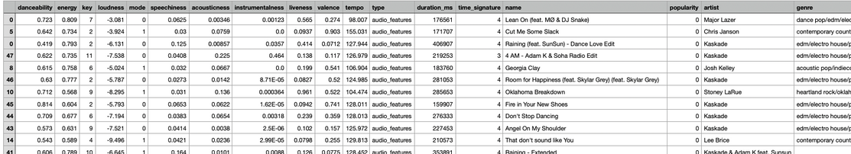
SAMPLE
COLLECTION
PRACTICAL MOTIVATION
VARIABLES FROM DATASET:
Danceability, Energy, Key, Loudness, Mode, Speechiness, Acousticness, Instrumentalness, Liveness, Valence, Tempo, Type, Duration_ms, Time_signature, Name, Popularity, Artist genre
01 INTRODUCTION

Slide 7
SAMPLE
COLLECTION
PRACTICAL MOTIVATION
POPULARITY == REVENUE
WILL A SONG BE WELL RECIEVED?
WHAT SONGS TO PUT IN AN ALBUM?
01 INTRODUCTION

Slide 8

DATA
PREPARATION
PROBLEM
FORMULATION
IS IT POSSIBLE TO PREDICT IF A SONG IS POPULAR?
01 PROBLEM STATEMENT

Slide 9

EXPLORATORY
DATA
ANALYSIS
02 EXPLORATORY DATA ANALYSIS

Slide 10

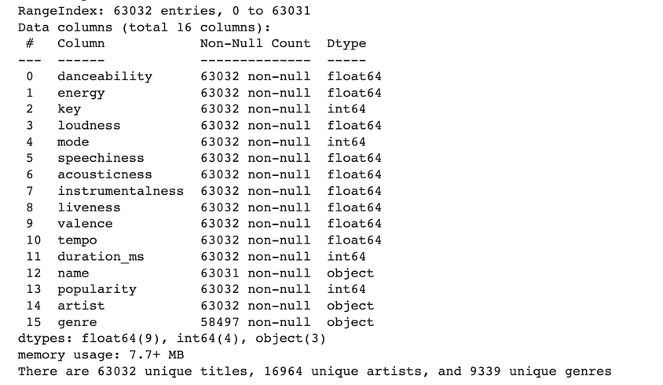
EXPLORATORY
ANALYSIS
STATISTICAL
DESCRIPTION
BASIC DATA CLEANING:
Dropping 'type' & 'time_signature' columns and N/A & duplicate values
02 EXPLORATORY DATA ANALYSIS

Slide 11
EXPLORATORY
ANALYSIS
STATISTICAL
DESCRIPTION
Numerical | Categorical
Danceability Energy Key Loudness Mode Speechiness Acousticness Instrumentalness Liveness Valence Tempo Duration_ms Popularity | Artist Genre
02 EXPLORATORY DATA ANALYSIS

Slide 12
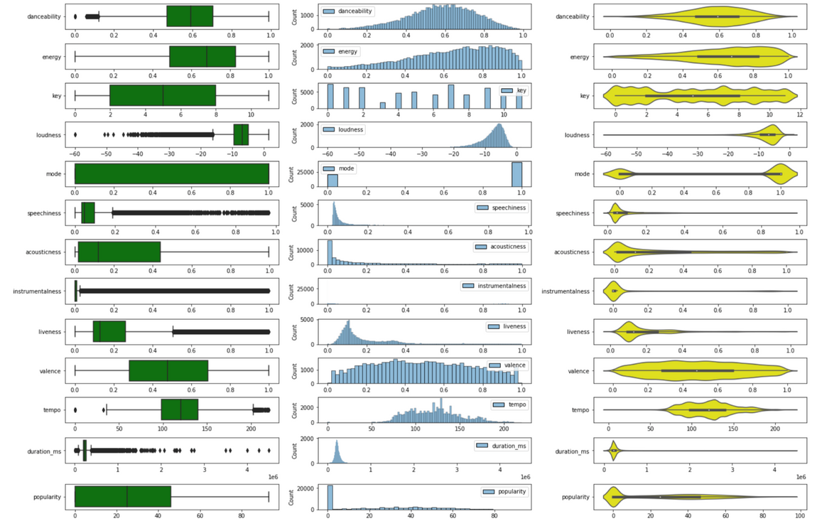
EXPLORATORY
ANALYSIS
STATISTICAL
DESCRIPTION
BASIC ANALYSIS (NUMERICAL)
02 EXPLORATORY DATA ANALYSIS
Notes:
- should speak on how it is bad lol
- used box, hist and violin for visualisation of numerical
distribution
- all aside from loudness have range 0-1
- something amis with instrumentalness

Slide 13
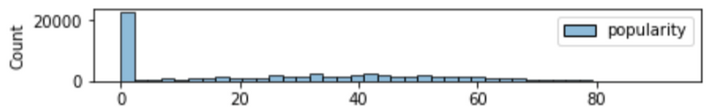
EXPLORATORY
ANALYSIS
STATISTICAL
DESCRIPTION
Disproportionate number of tracks with 0 popularity
02 EXPLORATORY DATA ANALYSIS
Notes:
- disproportionate number of tracks with 0 popularity by the spike in histogram and the bump in violin, zoomed in for histogram

Slide 14
EXPLORATORY
ANALYSIS
STATISTICAL
DESCRIPTION
ADVANCED DATA CLEANING
(NUMERICAL)
Remove data with 0 popularity
Normalise the data using min-max so each numerical value is between 0-1
02 EXPLORATORY DATA ANALYSIS

Slide 15
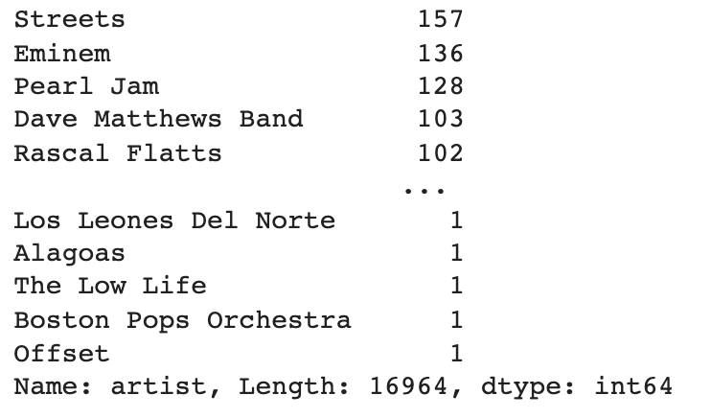
EXPLORATORY
ANALYSIS
STATISTICAL
DESCRIPTION
BASIC ANALYSIS (CATEGORICAL)
ARTIST
~17000 unique 'Artist' values
02 EXPLORATORY DATA ANALYSIS

Slide 16
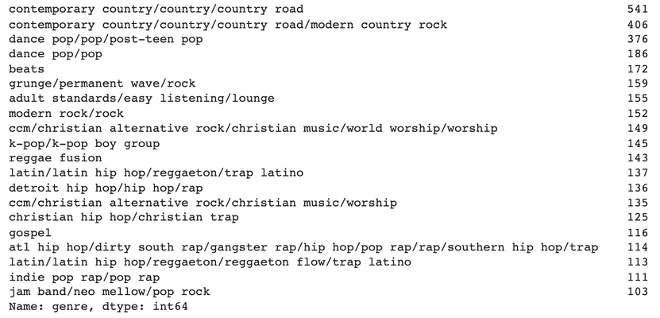
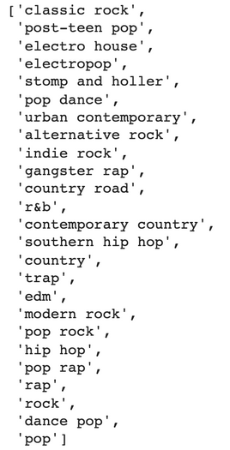
EXPLORATORY
ANALYSIS
STATISTICAL
DESCRIPTION
BASIC ANALYSIS (CATEGORICAL)
GENRE
before
after
02 EXPLORATORY DATA ANALYSIS

Slide 17
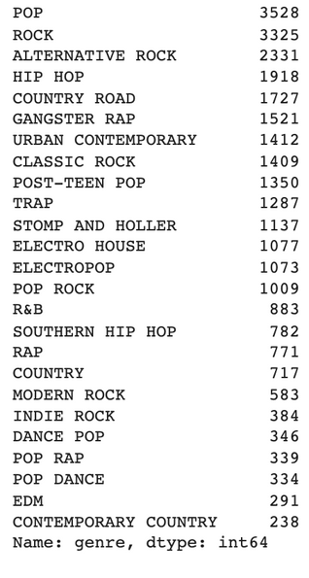
EXPLORATORY
ANALYSIS
STATISTICAL
DESCRIPTION
ADVANCED DATA CLEANING
(CATEGORY)
Replace 'na' with 'no genre'
Took top 25 genres as they represent 50% of the dataset
02 EXPLORATORY DATA ANALYSIS

Slide 18
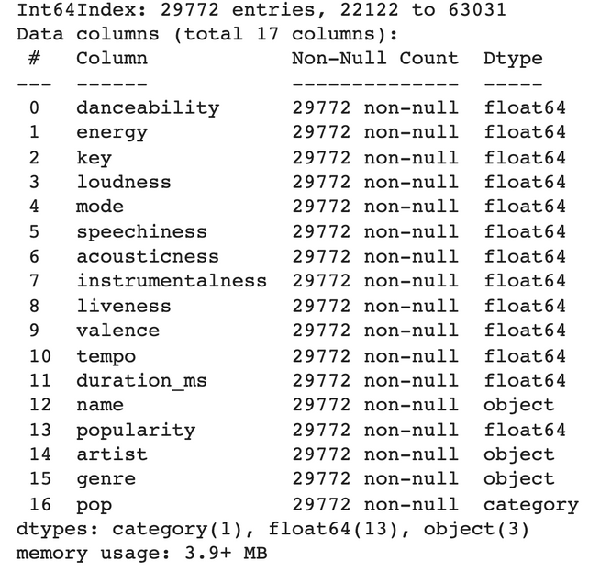
EXPLORATORY
ANALYSIS
STATISTICAL
DESCRIPTION
EXPLORATORY DATA ANALYSIS
- Post cleaning
29772 songs
17 columns
- Data was split into 2 classes:
"Pop" (>0.9) and "Not Pop"(<0.9)
02 EXPLORATORY DATA ANALYSIS

Slide 19
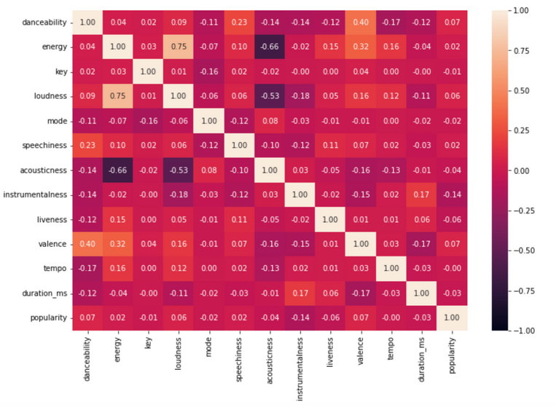
EXPLORATORY
ANALYSIS
STATISTICAL
DESCRIPTION
Relationship Visualisation between variables and popularity (heatmap)
Weak correlation
coefficients for
popularity
02 EXPLORATORY DATA ANALYSIS
Notes:
include why use heatmap, why find correlation coefficient

Slide 20
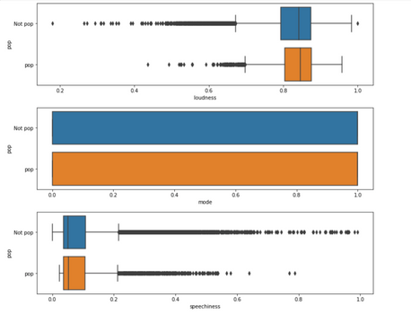
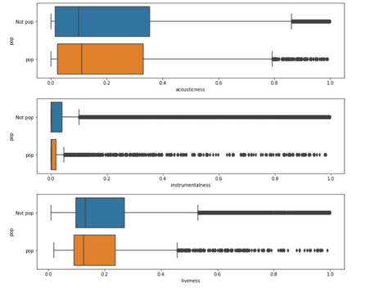
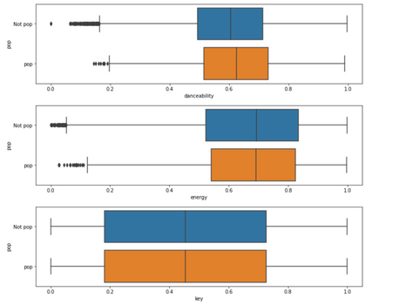
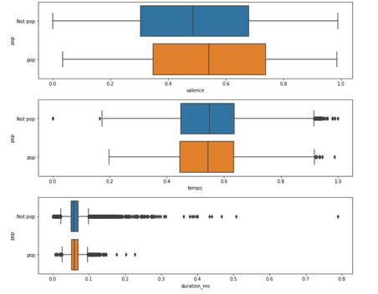
EXPLORATORY
ANALYSIS
STATISTICAL
DESCRIPTION
Relationship Visualisation between variables and popularity (box plot)
Hard to distinguish
between the 2 classes
02 EXPLORATORY DATA ANALYSIS
Notes:
include why use heatmap, why find correlation coefficient

Slide 21
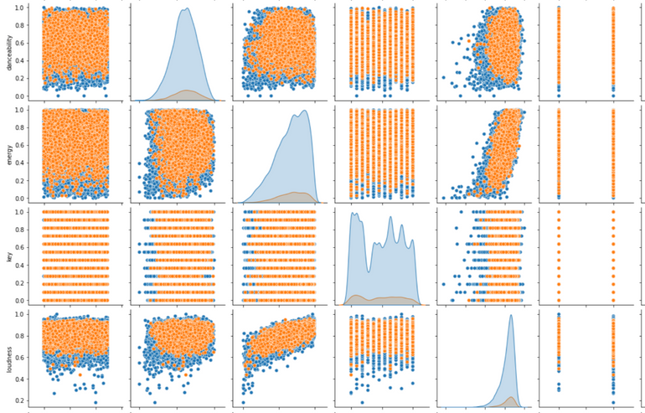
EXPLORATORY
ANALYSIS
STATISTICAL
DESCRIPTION
Relationship Visualisation between variables and popularity (pair plot)
Clusters are not clearly separated
Relationships not clearly distinguished
02 EXPLORATORY DATA ANALYSIS
Notes:
include why use heatmap, why find correlation coefficient

Slide 22

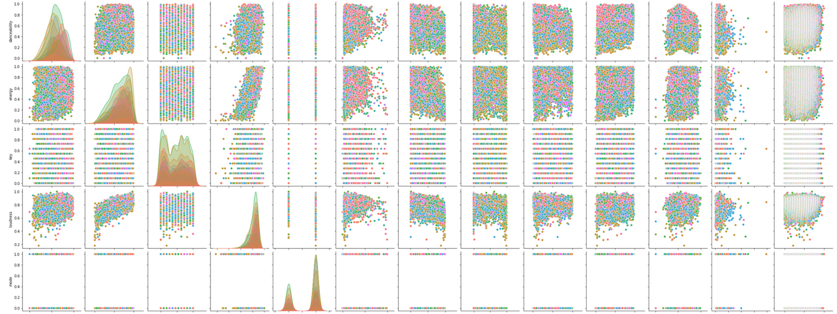
EXPLORATORY
ANALYSIS
STATISTICAL
DESCRIPTION
Relationship Visualisation between genres and popularity (pair plot)
(snipet of pairplot )
messy
same as other variables
02 EXPLORATORY DATA ANALYSIS
Notes:
include why use heatmap, why find correlation coefficient

Slide 23

ANALYTIC
VISUALISATION
PATTERN
RECOGNITION
Relationship Visualisation between variables and popularity (pair plot)
'key' and 'mode' have extremely poor pairplots
02 EXPLORATORY DATA ANALYSIS
Notes:
include why use heatmap, why find correlation coefficient

Slide 24
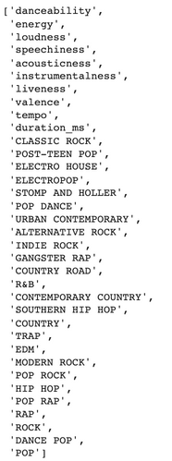
ANALYTIC
VISUALISATION
PATTERN
RECOGNITION
Features Selected
 | Danceability Energy Loudness Speechiness Acousticness Instrumentalness Liveness Valence Tempo Duration_ms + top 25 genres
02 EXPLORATORY DATA ANALYSIS
Notes:
converting the categorical data variables to be provided to machine and deep learning algorithms which in turn improve predictions as well as classification accuracy of a model.

Slide 25
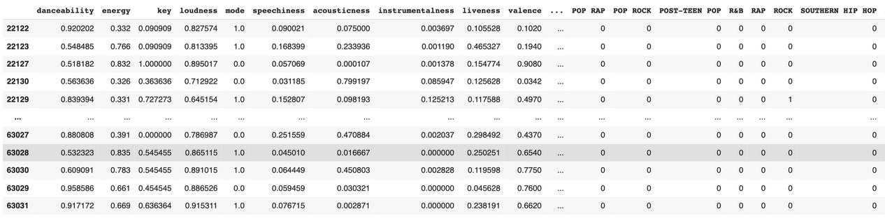
ANALYTIC
VISUALISATION
PATTERN
RECOGNITION
ONE HOT ENCODING
Preprocessing categorical data for Machine Learning
02 EXPLORATORY DATA ANALYSIS
Notes:
include why use heatmap, why find correlation coefficient

Slide 26

MACHINE
LEARNING
DECISION TREE
RANDOM FOREST
K-NEAREST NEIGHBOUR
LOGISTIC REGRESSION*
GRADIENT BOOSTING*
03 MACHINE LEARNING
*
WILL NOT BE COVERED IN PRESENTATION

Slide 27

ALGORITHMIC
OPTIMISATION
MACHINE
LEARNING
SPLITTING DATASET
Random split into train and test set
WHAT ARE WE LOOKING FOR?
Balanced Accuracy Score
The arithmetic mean of sensitivity and specificity
Used to evaluate how good a classifier is
02 EXPLORATORY DATA ANALYSIS

Slide 28
ALGORITHMIC
OPTIMISATION
MACHINE
LEARNING
GRID SEARCH
Uses a different combination of all the specified hyperparameters and their values and calculates the performance for each combination and selects the best value for the hyperparameters
03 MACHINE LEARNING

Slide 29
ALGORITHMIC
OPTIMISATION
MACHINE
LEARNING
DECISION TREE
Supervised Machine Learning Algorithm where the data is continuously split according to a certain parameter (popularity)
03 MACHINE LEARNING

Slide 30
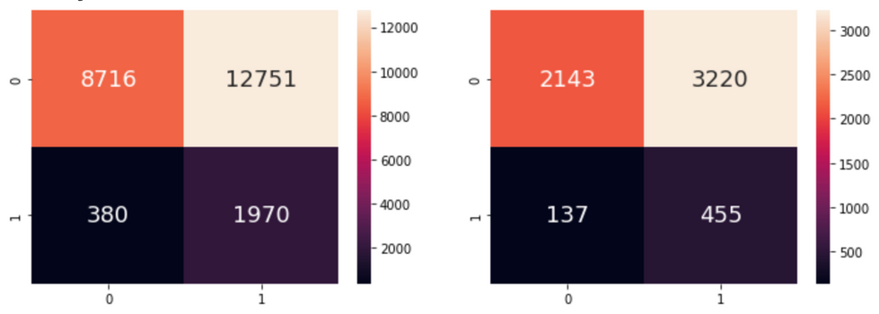
ALGORITHMIC
OPTIMISATION
MACHINE
LEARNING
DECISION TREE
Class_weight = "balanced" for imbalanced data
Balanced accuracy score = 58.4%
Decent TPR (76%) but poor TNR (39.9%)
03 MACHINE LEARNING

Slide 31
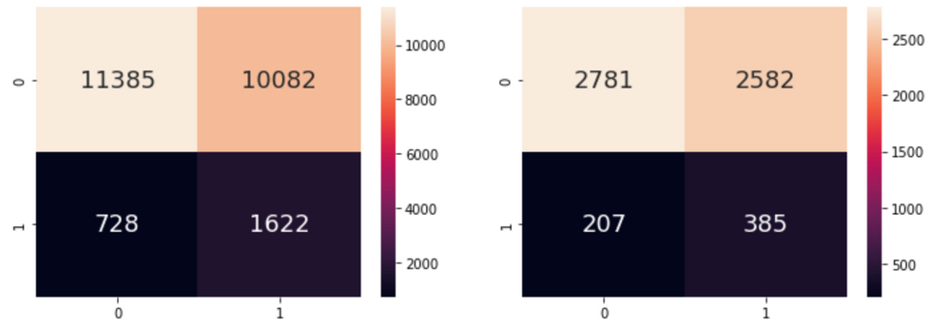
ALGORITHMIC
OPTIMISATION
MACHINE
LEARNING
DECISION TREE
(POST FINE TUNING USING GRID SEARCH)
TNR improved by 12%
Balanced Accuracy Score remains 58.4%
03 MACHINE LEARNING
Notes:
max_depth - limits the maximum depth that the tree can go
max_leaf_nodes - limits the number of leaf nodes the tree can have
min_sample_split - requires a branch to have a certain number of samples before splitting is allowed
max_features - restricts the number of features to be considered for splitting

Slide 32
ALGORITHMIC
OPTIMISATION
MACHINE
LEARNING
RANDOM FOREST
Supervised Machine Learning Algorithm that builds decision trees on different samples and takes their majority vote for classification and average in case of regression.
03 MACHINE LEARNING

Slide 33
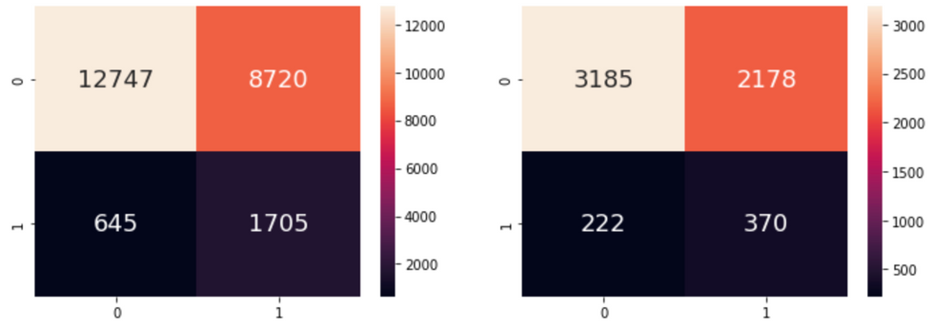
ALGORITHMIC
OPTIMISATION
MACHINE
LEARNING
RANDOM FOREST
(POST FINE TUNING USING GRID SEARCH)
Balanced Accuracy Score = 60.9% (slight improvement from decision tree but not very significant)
03 MACHINE LEARNING

Slide 34
ALGORITHMIC
OPTIMISATION
MACHINE
LEARNING
K-NEAREST NEIGHBOUR (KNN)
Supervised Machine Learning Algorithm that finds the distances between a query (popularity) and all the examples in the data, selecting the specified number examples (K) closest to the query, then votes for the most frequent label
03 MACHINE LEARNING

Slide 35
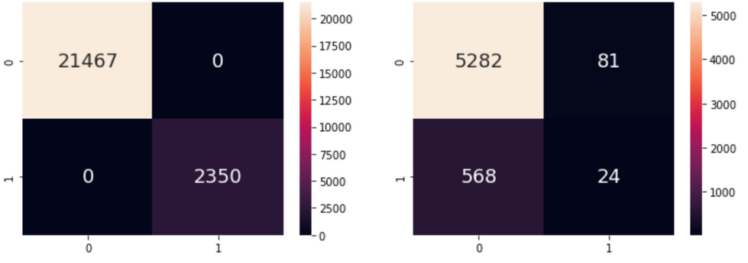
ALGORITHMIC
OPTIMISATION
MACHINE
LEARNING
K-NEAREST NEIGHBOUR
(POST FINE TUNING USING GRID SEARCH)
Balanced Accuracy Score = 51.2% (lowest of all the models)
03 MACHINE LEARNING

Slide 36

INFORMATION
PRESENTATION
STATISTICAL
INFERENCE
WHY OUR MODELS WERE CHOSEN
Appropriateness against our existing data set
Accuracy and ability to achieve our goal (as per problem definition)
WHY BALANCED ACCURACY SCORE?
Tackles the issue of imbalance by adjusting the weight of classes according to their frequency
Appropriate to combat overfitting due to over-sampling
03 MACHINE LEARNING
Notes:
used models that can be used for categorical data
In supervised learning, we alrdy have labeled data. And the goal is to predict outcomes for new data (if a song will be popular) which is an outcome of supervised learning as unsupervised learning simply shows insights into large amounts of new data . Supervised learning better used for prediction.

Slide 37
INFORMATION
PRESENTATION
STATISTICAL
INFERENCE
COMPARING RESULTS ACROSS MODELS
Random Forest was the best model as it yielded the highest balance accuracy score of 60.9%
IMPROVEMENT OF RESULTS POST GRID SEARCH
E.g. 1% increase for balance accuracy score of k-nearest neighbour
03 MACHINE LEARNING

Slide 38


INSIGHTS
- OUTCOME
- SUBSEQUENT RECOMMENDATIONS
- TECHNIQUES LEARNT
- CONCLUSION
03 MACHINE LEARNING

Slide 39
INFORMATION
PRESENTATION
STATISTICAL
INFERENCE
OUTCOME
No strong correlation between popularity and any univariate variable
Balance Accuracy Score remained < 60%
Insufficient independent variables, weak dependent variable
Large disproportion between number of popular songs and not popular songs
03 MACHINE LEARNING

Slide 40
INFORMATION
PRESENTATION
STATISTICAL
INFERENCE
SUBSEQUENT RECOMMENDATIONS
Increase proportion of 'popular' songs to ensure dataset is balanced or adopt over-sampling / under-sampling
Identify more possible variables
Use songs' lifetime streams as popularity metric
Break down popularity into more subsets, e.g. 'region', 'time period'
03 MACHINE LEARNING

Slide 41


ETHICAL
CONSIDERATION
INTELLIGENT
DECISION
TECHNIQUES LEARNT
One-hot encoding
Random forest
K-nearest neighbors (KNN)
Gradient boosting
03 MACHINE LEARNING

Slide 42
ETHICAL
CONSIDERATION
INTELLIGENT
DECISION
CONCLUSION / DATA DRIVEN INSIGHTS
Popularity can possibly be predicted. However, many additional variables need to be considered
Existing trends in music
Social media / Marketing
Artist
03 MACHINE LEARNING

Slide 43


THANK YOU!

